Slide 1
Stock Recommendation Engine
A source deck for use in university presentations
Division of Communications and Marketing
Updated October 2019

Slide 2
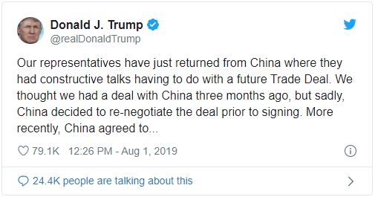
Power of Social Media
Just as actions in the stock market are contagious, emotions in social media are contagious!
President Donald Trump’s frequent Twitter posts move the stock market
Ex1: In early August, there was the plunge in the stocks after Trump announced that he planned to place 10% tariffs on $300 billion worth of imports from China. The S&P 500 fell 0.9% that Thursday and tumbled almost 3% the next Monday and the Dow Jones Industrial average slid 2.4% as the Chinese Yuan fell against the dollar.
Trump's trade-focused tweets often
drive investors to lower their interest
rate
Tweets pertaining to stocks with
either positive or negative sentiment
may have a rippling effect, all before
hitting the stock market.
Notes:
It’s possible that the more people who post positively about a stock, the more likely other people in their social media network are to post positively about the stock, or at least feel positively about the stock themselves.

Slide 3
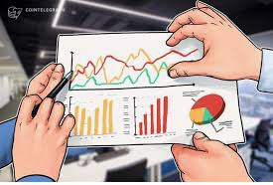
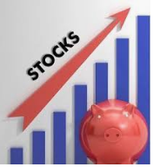
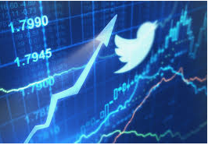
The Stock Market: past and present
Before investors choose to go with the momentum of the stock market and assume stocks will continue going in the same direction in the future as they are now.
Cons: Trusting your instinct may not be rational
Today Twitter can be very useful in Forecasting which markets are thriving and where money is most likely to be invested
Pros: Aggregating financial tweets and labeling them as positive or negative can help determine how the general public feels about a certain stock.

Slide 4
Where Our Project Comes In?
Today finance is becoming increasingly about technology and data science
Our project aims to be a proof of concept for implementing recommendation system for guiding stock market investment
It uses machine learning principles and sentiment analysis to find correlation between “market sentiment” and “public sentiment”
We used Yahoo finance API to fetch real time stock market data and Twitter newsfeed to measure impact on those stock data
Stock market prices and Twitter news feed are collected periodically for five different companies and our system gives the feedback for each one of them.

Slide 5
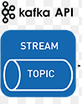
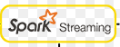
Business Logic
DATA COLLECT PROCESS STORE RESULT
Google
Google Stock
Microsoft Stock
S3 Bucket
Tesla
Tesla Stock
Twitter Tweets for Google, Microsoft and Tesla
Microsoft

Slide 6
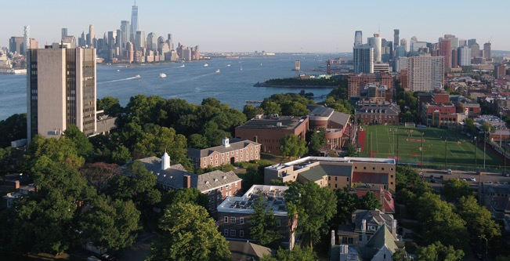
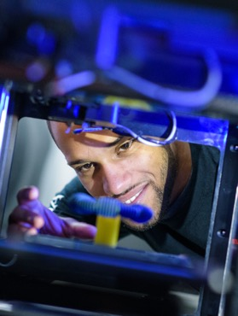
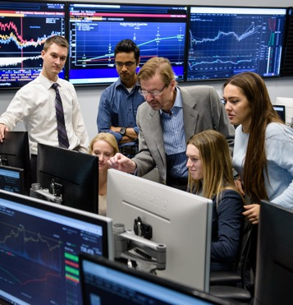
A Student-Centric, Technological Research University
Established in 1870 by America’s first family of inventors
Located in Hoboken, New Jersey, minutes from Manhattan
Prepares leaders for our technology-driven world
Advances science and technology education and research in areas of great societal need
Contributes to the study and solution of the most challenging problems of our time

Slide 7
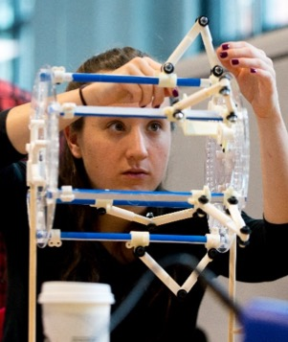
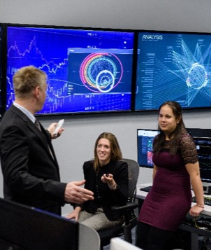
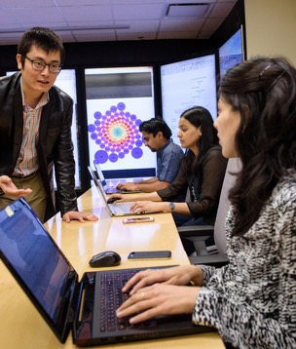
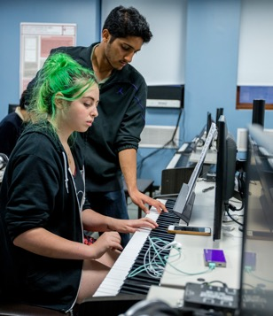
Technology-Focused, Broad Reach
Charles V. Schaefer, Jr. School of Engineering and Science
Advancing scientific knowledge to create groundbreaking solutions to 21st-century challenges
School of Business
Leading innovation in business management and finance, across industries and around the globe
School of Systems and Enterprises
Optimizing the design, creation and operation of complex systems and organizations
College of Arts and Letters
Uniting humanities, arts, science and technology to inspire and inform change and innovation

Slide 8
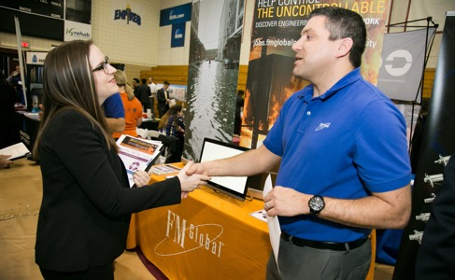
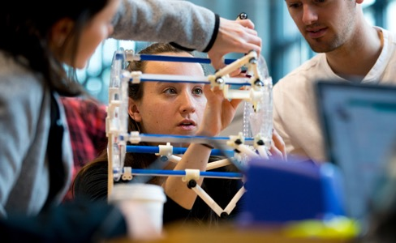
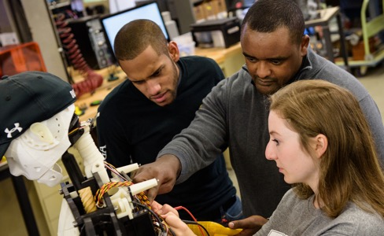
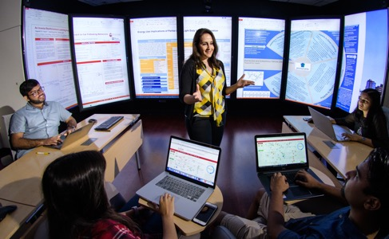
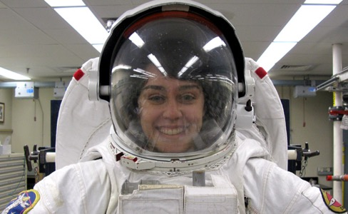
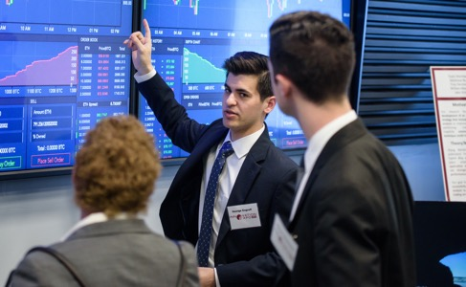
Driven by Real-World Experience
Cooperative education
Project-based learning
Faculty-mentored research
Case studies drawn from industry
Internships
Cross-disciplinary collaboration, reflective of real-world projects

Slide 9
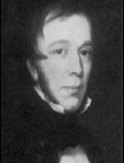
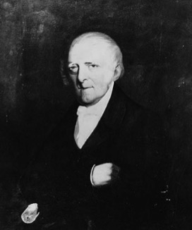
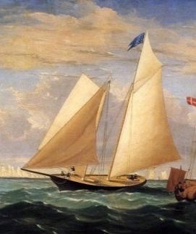
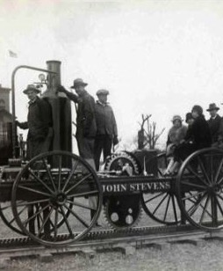
Legacy of Innovation
The Stevens family: The first family of American inventors
Introduced the first mechanical engineering degree in the U.S.
Designed the steam ferry, the T-rail and the first American-built steam locomotive
Built and operated the first U.S. commercial railroad
Instrumental in developing U.S. patent law
Created the America’s Cup racing series and designed and sailed the yacht America, the first winner of the Cup
Edwin A. Stevens
Colonel John Stevens III
The yacht America
John Stevens’ original steam carriage

Slide 10
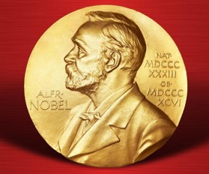
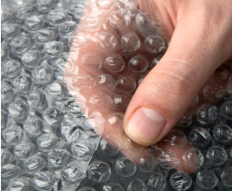

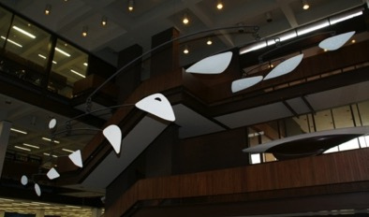
Once and Future Pioneers
Stevens alumni have followed in the footsteps of the university’s founding family to become modern-day game-changers:
Created the field of scientific management
Invented the Gantt Chart
Co-founded GM and Texas Instruments
Won a Nobel Prize for discovering the neutrino, a key component of the Big Bang theory
Created the art form known as the mobile
Directed command, service and lunar module design for NASA’s Apollo moon missions
Invented the IMAP email protocol
Invented bubble wrap

Slide 11
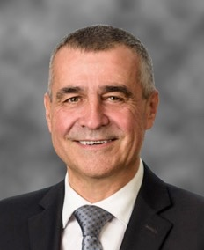
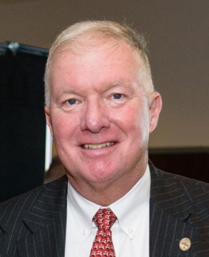
Stevens Leadership
Nariman Farvardin, President
A distinguished higher education leader and accomplished researcher, entrepreneur and inventor in data communication, image coding and wireless communication
Christophe Pierre, Provost & VP of Academic Affairs
An accomplished academic administrator and an internationally acclaimed scholar in the fields of vibration and structural dynamics
Stephen T. Boswell, Chairman of the Board of Trustees
President and CEO of Boswell Engineering, co-founder of ConnectOne Bank and trustee of Hackensack Meridian Health

Slide 12
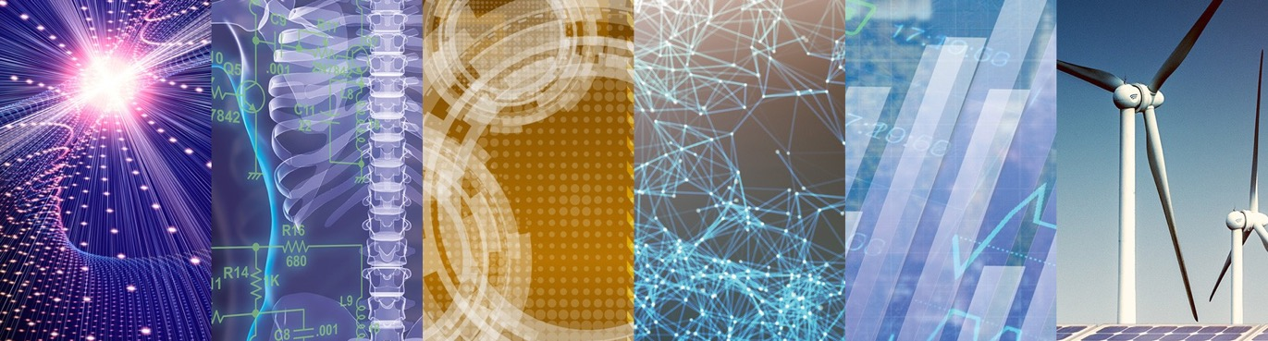
Foundational Research Pillars
Areas of Focus:
Artificial Intelligence, Machine Learning and Cybersecurity
Biomedical Engineering, Healthcare and Life Sciences
Complex Systems and Networks
Data Science and Information Systems
Financial Systems and Technologies
Resilience and Sustainability
More than $30.9 million in research expenditures in FY17
More than $42 million in research expenditures in FY18

Slide 13
University Facts
3,431 Undergraduate Students | 3,498 Graduate Students | 10:1 Undergraduate Student-faculty Ratio | 290 Full-time Faculty
34 Undergraduate Majors | 54 Master’s Programs | 22 Ph.D. Programs | DEGREES: B.E., B.S., B.A., Engineer, M.S., M.A., M.Eng., MBA, Ph.D.
14 Active Research Centers | 95% First-year Retention Rate | 87% 6-year Graduation Rate
Enrollment figures reflect Fall 2018 census

Slide 14






National Rankings and Recognition
#15
For Return on Investment
20-year net return on investment (with financial aid), 2018 College ROI Report
#4
Top Earnings
Ranked among the 30 U.S. “colleges where students go on to earn the most money,” 2018
14
Increase
In U.S. News & World Report’s ranking of the Top National Universities, from 88 in 2012 to 74 in the 2020 edition
#7
Career Placement
Best Value Colleges, 2019
Top 25
Most Innovative Colleges
U.S. News & World Report National Universities, 2018 edition
Top 25
For Internships
Best Value Colleges, 2019
#13
For Mid-Career Salaries
2019-2020 College Salary Report
#2
Smallest Gender Gap in Pay
As reported in Forbes, 2018
Named by MarketWatch as one of the top schools in the nation where WOMEN IN STEM flourish, 2016

Slide 15


National Program Rankings
Graduate Program Rankings
Undergraduate
Program Rankings
#8
Online Graduate Computer Information Technology Programs
U.S. News & World Report, 2019
#14
Online Graduate Business
Programs (non-MBA)
U.S. News & World Report, 2019
#9
Computer Science Degree USA Today, 2016
#45
Online MBA
U.S. News & World Report, 2019
#22
Online Graduate
Engineering Programs
U.S. News & World Report, 2019
#1
Online Master’s in Information Science College Values Online, 2017
3 Top 20
Business Master’s Programs (Business Analytics, Management, Financial Engineering) The Financial Engineer, 2018-2019
#33
Systems Engineering U.S. News & World Report, 2020

Slide 16
A University on the Rise
Class of 2022
The largest and most
academically talented freshman
class in Stevens history
SAT Range: 1330-1480
(middle 50%)
Unprecedented
Graduate Enrollment Growth
Prospective student interest is
stronger than ever.
157%
9,265 First-Time, Full-Time Applicants
145%
7,892 Applications
81%
1,009 First-Time, Full-Time
New Students
16%
3,498 Graduate Enrollment
41%
3,431 Undergraduate
Enrollment
73%
2,274 Full-Time Graduate Students
Enrollment figures reflect Fall 2018 census data. Percent increases reflect growth since 2011.

Slide 17
Lifelong Returns
Stellar student outcomes are a Stevens standard
$71,400
Average starting salary of graduates
96%
of students secured intended outcomes within six months of graduation
79%
had their outcomes finalized prior to graduation
Data from the Career Outcomes Report for the Class of 2018

Slide 18








Stevens in the News
National media attention for topics ranging from leadership and financial systems to coastal resiliency and cybersecurity.
 | A Fingernail-Size Gadget Could Prevent Babies From Being Stillborn 8/9/2019 |  |  | How Big A Threat Is An Electromagnetic Attack? 7/27/2019
 | Football’s Concussion Crisis Is Awash With Pseudoscience 10/2/2019 |  |  | Bursting the Aquarium Bubble 4/25/2019
 | Have You Seen Any Nazi Uranium? These Researchers Want to Know 8/31/2019 |  |  | CEO Hubris Costs Millions 10/13/2018
 | Quantum Gravity Could Reverse Cause And Effect 8/29/2019 |  |  | AI Could Make Cyberattacks More Dangerous, Harder to Detect 11/13/2018

Slide 19

Global Reach
A vast international network offers boundless opportunities in our global economy.
Students from 40 states and 54 countries and alumni from every region of the world
Global international student exchange agreements
Study abroad opportunities
Global academic partnerships
Worldwide research programs
Partnerships with multinational corporations and governments
Geographic data reflects Fall 2018 census

Slide 20
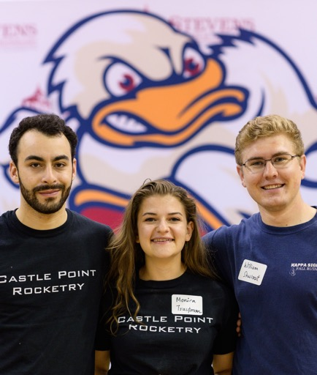
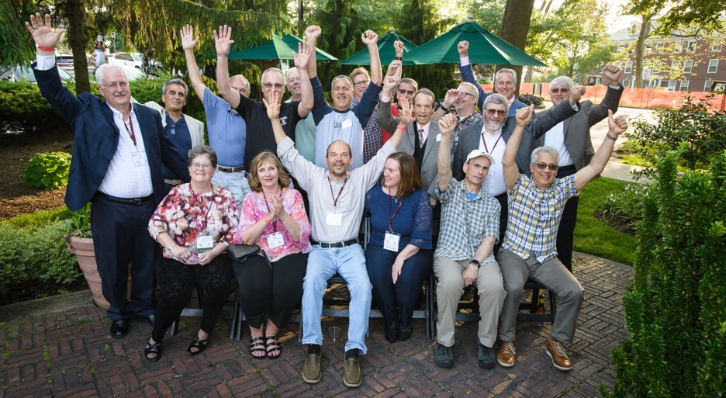
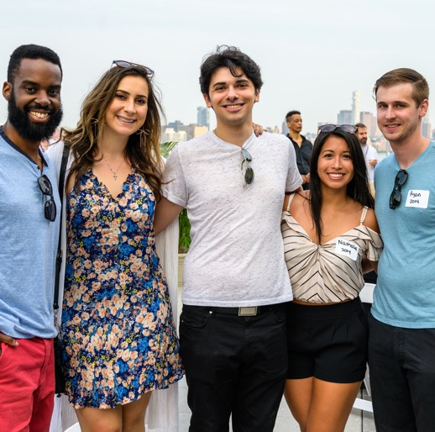
The Stevens Alumni Network
Stevens alumni are leaders in companies as diverse as United Technologies Corporation, PSEG, Healthfirst, Merck, Citibank, SAP, Goldman Sachs and AT&T.
40,000+Alumni
More than 80
countries represented
20+ official clubs worldwide

Slide 21

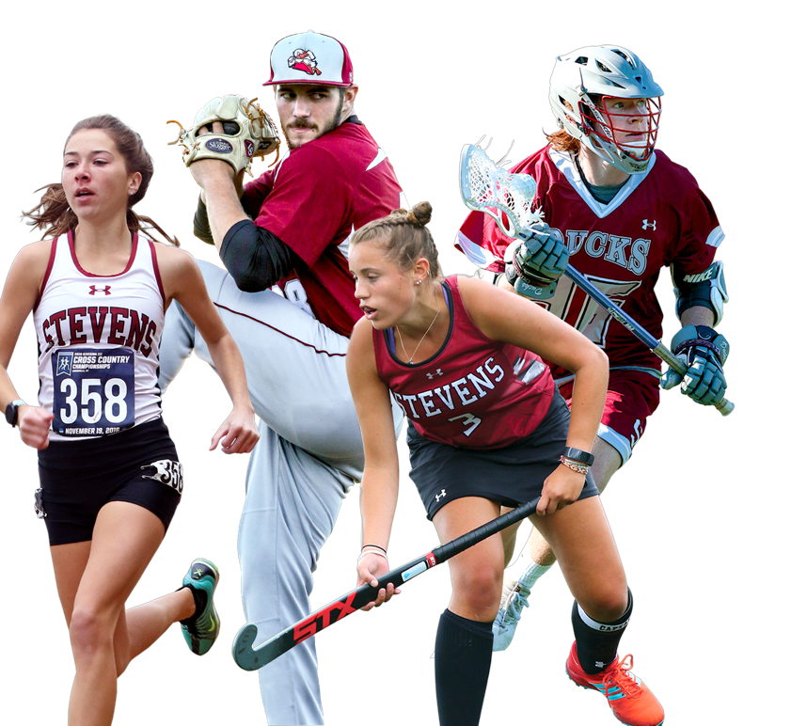
Athletics
25 Division III Varsity Sports
Member of the MAC (Middle Atlantic Conference)
Combined cumulative GPA for all varsity sports > 3.5
10 COSIDA Academic All-Americans since 2012
15 national titles since 2011
11 consecutive top-50 placements in the Learfield Sports Directors’ Cup for national program-wide success

Slide 22
Innovation Applied
A unique and powerful academic experience

Slide 23
Research Centers and Labs
University Level
Center for Complex Systems and Enterprises (CCSE)
Center for Decision Technologies (CDT)
Center for Environmental Systems (CES)
Center for Healthcare Innovation (CHI)
Center for Innovation in Engineering and Science Education (CIESE)
Center for Quantum Science and Engineering (CQSE)
Davidson Laboratory
Hanlon Financial Systems Center (FSC)
Highly Filled Materials Institute (HfMI)
The New Jersey Center for MicroChemical Systems (NJCMCS)
Sensor Technology & Applied Research Center (STAR)
Stevens Institute for Artificial Intelligence (SIAI)
Department Level
Center for the Advancement of Secure Systems & Information Assurance (CASSIA)
Design & Manufacturing Institute (DMI)
Stevens Alliance for Innovation and Leadership (SAIL)

Slide 24
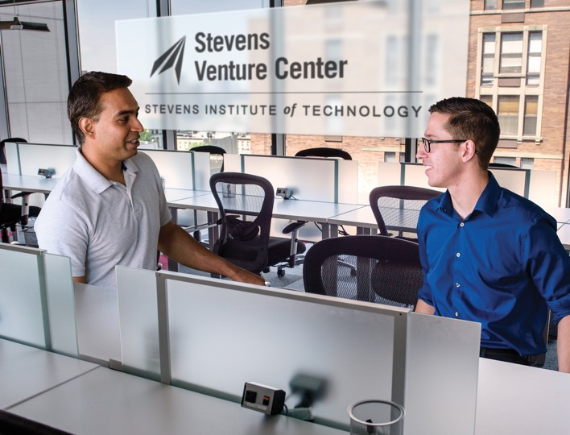
The Stevens Venture Center: Fueling Entrepreneurship
A dynamic, collaborative environment where selected entrepreneurs can develop promising concepts and technologies into thriving businesses
Technology support
Opportunities to share best practices and experiences
Networking
Access to legal and accounting experts and investors
Education in building a successful business
The SVC provides the infrastructure, resources, training and support to bring entrepreneurial dreams closer to reality.

Slide 25



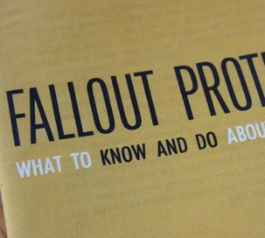
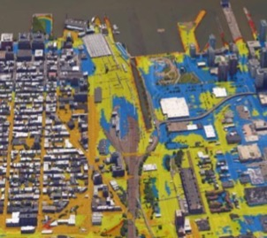


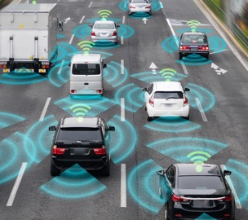
Shaping the Future
Stevens research tackles some of the most urgent challenges facing our world today.
Resilient engineering
Energy innovation
Healthcare delivery
Nuclear preparedness
and civil defense
Flood forecasting and preparation
Biomedical research and drug discovery
Cybersecurity
Transportation planning

Slide 26

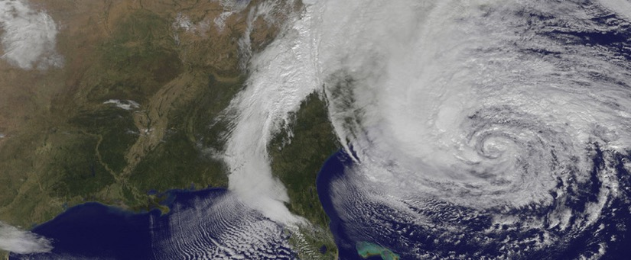
National Centers of Excellence
The Systems Engineering Research Center (SERC) provides systems thought leadership to manage critical challenges facing the U.S. defense sector.
The Center for Maritime Security (CMS) leads national efforts in maritime security and ocean observation.

Slide 27
Thank You

